Slide 1
Dark current compensation of a CMOS image sensor by using in pixel temperature

Slide 2
outline
Introduction
Background on Dark Current
Importance of Compensation
Methods of Dark Current Compensation
Implementation Strategies
Performance Evaluation
Recent Developments and Future Trends
Conclusion

Slide 3
introduction

Slide 4
introduction

Slide 5
introduction

Slide 6
Background on Dark Current

Slide 7
Background on Dark Current

Slide 8
Background on Dark Current

Slide 9
Importance of Compensation

Slide 10
Importance of Compensation

Slide 11
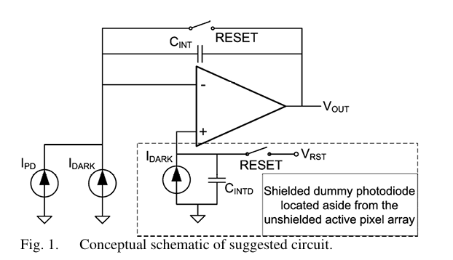
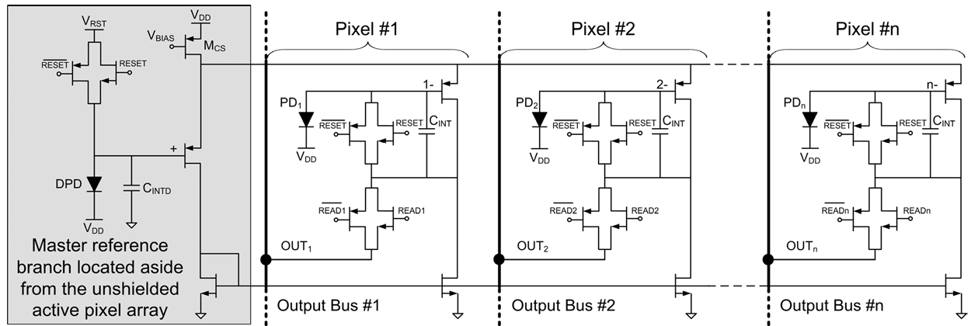
Methods of Dark Current Compensation
Differential Pixel Architecture

Slide 12
Methods of Dark Current Compensation
Differential Pixel Architecture (APS)

Slide 13
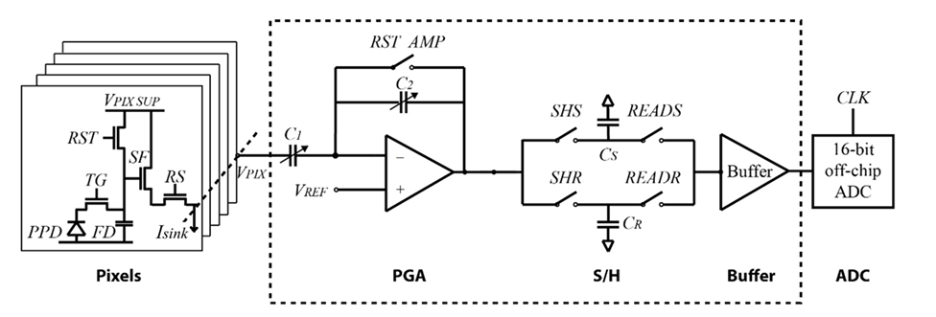
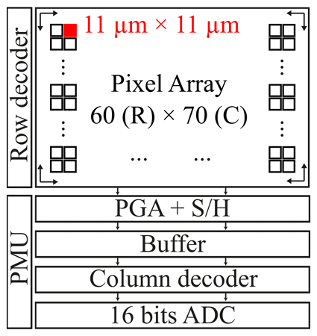
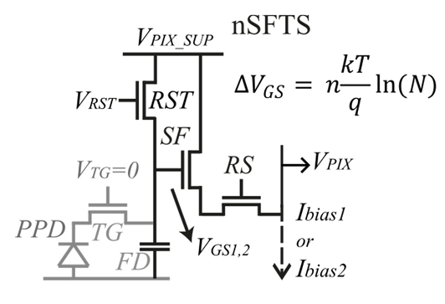
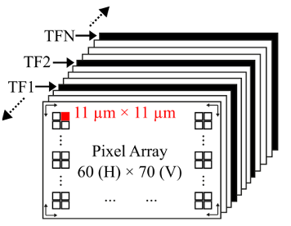
CMOS Image Sensor with In-Pixel Temperature Sensors
Methods of Dark Current Compensation

Slide 14
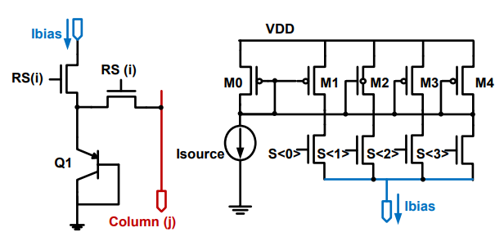
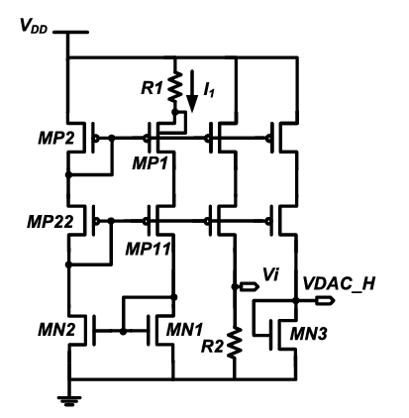
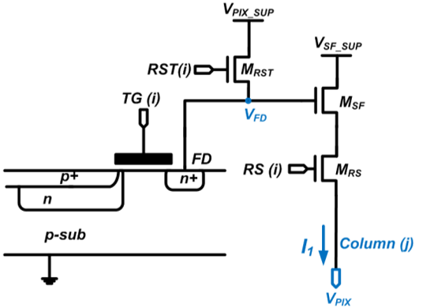

Methods of Dark Current Compensation
Imager based temperature sensor front-end

Slide 15
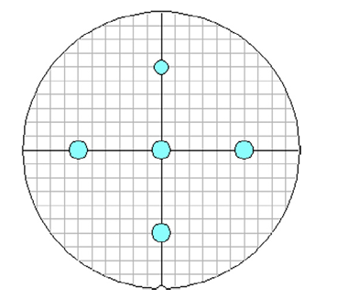
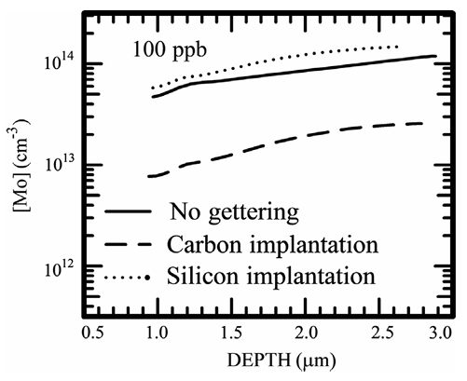
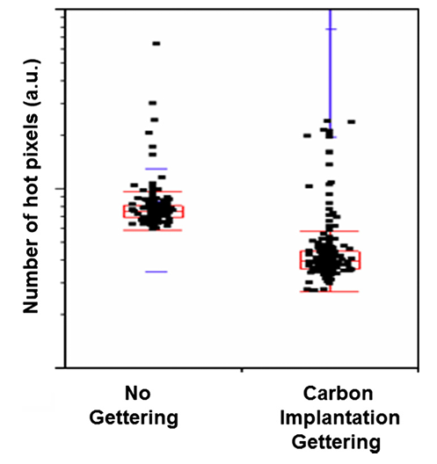
Methods of Dark Current Compensation
Proximity gettering of slow diffuser contaminants in CMOS image sensors

Slide 16
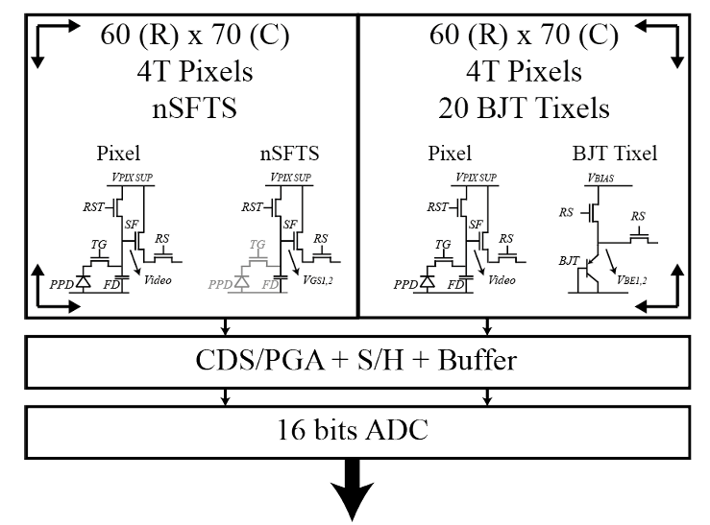
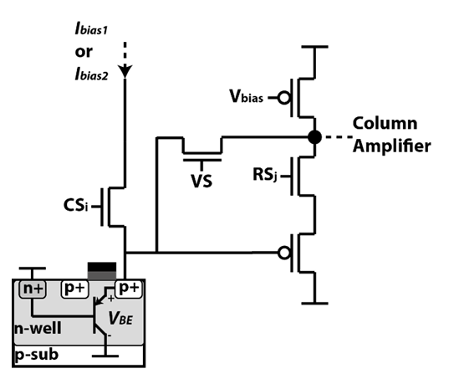
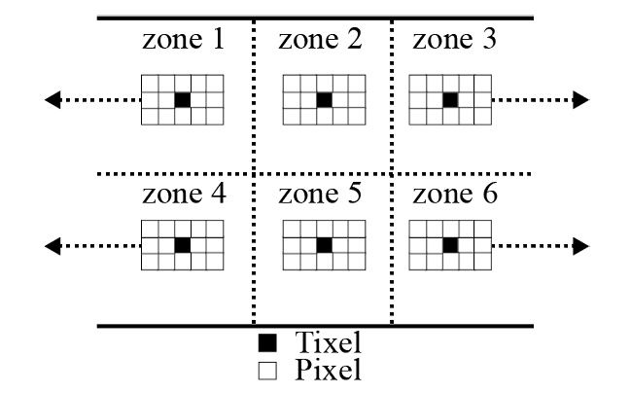
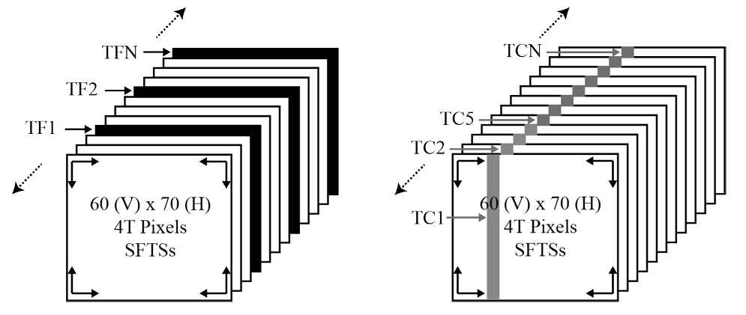
Methods of Dark Current Compensation
In-pixel temperature sensors for dark current compensation of a CMOS image sensor

Slide 17
Methods of Dark Current Compensation

Slide 18
Methods of Dark Current Compensation

Slide 19
Implementation Strategies

Slide 20
Implementation Strategies

Slide 21
Implementation Strategies

Slide 22
Performance Evaluation

Slide 23
Performance Evaluation

Slide 24
Performance Evaluation

Slide 25
Recent Developments and Future Trends

Slide 26
Recent Developments and Future Trends

Slide 27
Conclusion

